Slide 1
Monte Carlo Simulation for Etching Thickness Analysis
Overview of the simulation process for analyzing etching thickness in semiconductor manufacturing.

Slide 2
Imports and User Input Function
Imports necessary libraries (numpy, matplotlib, tkinter, etc.) and defines a function to get user input through a GUI.
This part ensures the required libraries are available and user inputs are properly taken for the simulation.
import numpy as np
import matplotlib.pyplot as plt
from scipy.stats import norm
import tkinter as tk
from tkinter import simpledialog, messagebox

Slide 3
User Input Dialog
Defines the function 'get_user_inputs()' to prompt the user for inputs such as etch rate, thickness, and other parameters.
This function ensures user-specific parameters are inputted for the Monte Carlo simulation.
def get_user_inputs():
root = tk.Tk()
root.withdraw() # Hide the root window
input_dialog = tk.Toplevel()
input_dialog.title('Enter Etching Parameters')

Slide 4
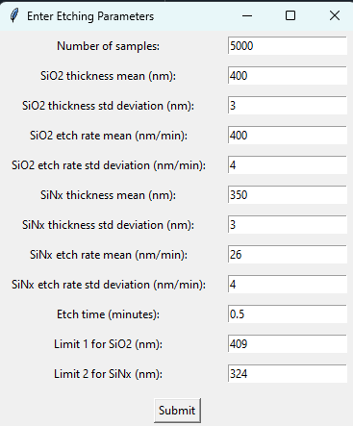

Slide 5
Main Code Setup
Defines the main code that initializes the inputs and sets the Monte Carlo simulation parameters.
This part sets up the initial values and retrieves user inputs needed for the simulation.
if __name__ == '__main__':
inputs = get_user_inputs()
num_samples = inputs['num_samples']
thickness_SiO2_mean = inputs['thickness_SiO2_mean']

Slide 6
Generate Random Samples
Defines the function to generate random samples for thickness and etch rate based on user inputted mean and standard deviation.
This function uses a normal distribution to simulate variations in etching parameters.
def generate_random_samples(mean, std, num_samples):
return np.random.normal(mean, std, num_samples)

Slide 7
Calculate Remaining Thickness
Defines the function to calculate the remaining thickness after the etching process.
This function helps in determining the etched amount and calculates the remaining material thickness.
def calculate_remaining_thickness(initial_thickness, etch_rate, etch_time):
etched_amount = etch_rate * etch_time
return np.maximum(initial_thickness - etched_amount, 0)

Slide 8
Plotting Results
Defines functions to plot histograms and bar charts for visualizing the distribution of remaining thicknesses.
These plots provide insights into the distribution and variation in the etching process outcomes.
def plot_histogram(ax, data, bins, color, label, title, xlabel, ylabel, mean_line=None):
ax.hist(data, bins=bins, alpha=0.5, color=color, label=label)
if mean_line is not None:
ax.axvline(mean_line, color='red', linestyle='--', label=f'Mean: {mean_line:.1f} nm')

Slide 9
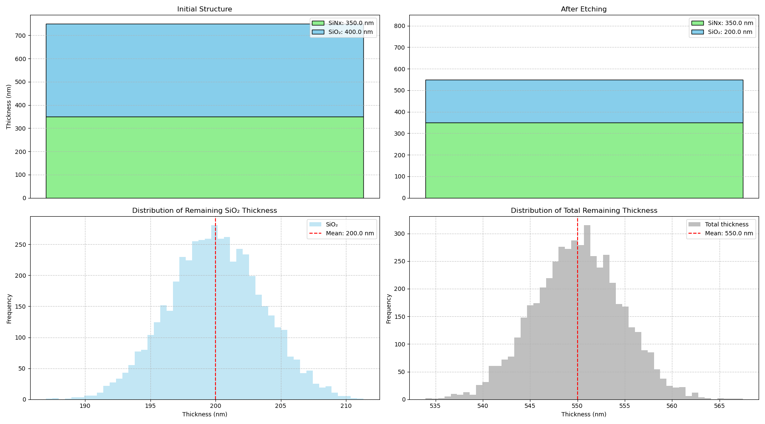
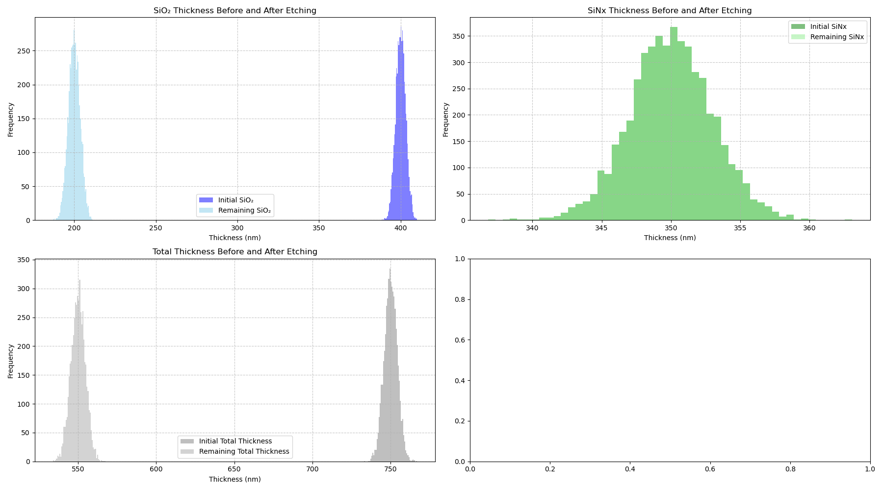

Slide 10
Area Under Remaining Normal Distribution
Calculates the area under the remaining normal distribution curve for a given value.
This function helps quantify the proportion of material below a specific threshold after etching.
def calculate_area_remaining(value, material='SiO2'):
mean = mean_remaining_SiO2 if material == 'SiO2' else mean_remaining_SiNx
std = np.std(remaining_SiO2) if material == 'SiO2' else np.std(remaining_SiNx)
cdf_value = norm.cdf(value, mean, std)

Slide 11
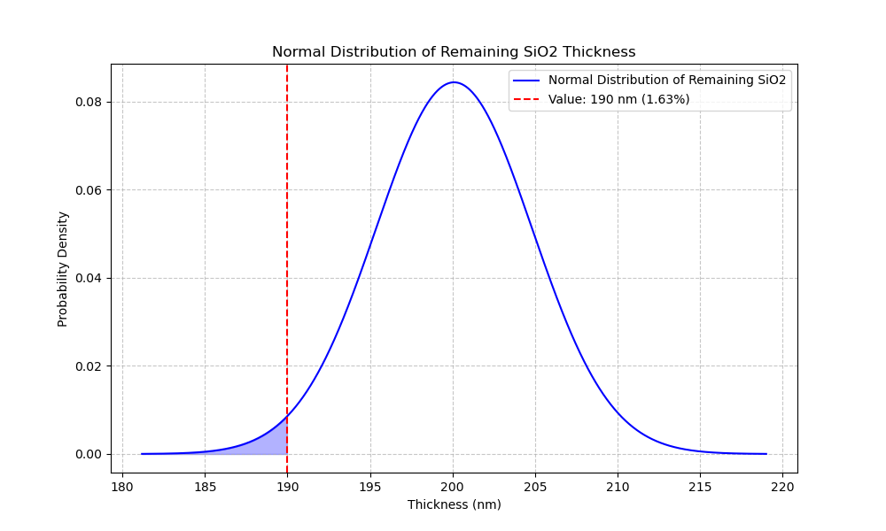
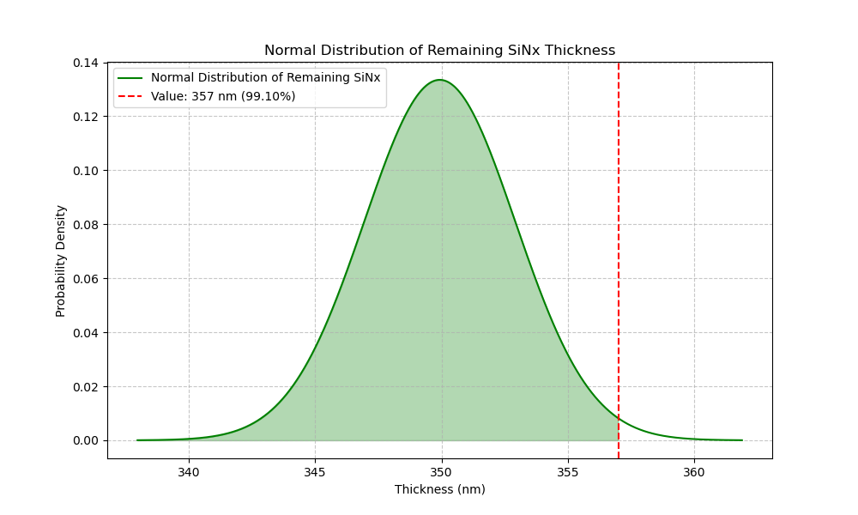

Slide 12
Summary and Results
Summarizes the results of the etching process after running the simulation, including mean and standard deviation of remaining thicknesses.
The results provide an overview of the impact of variability in parameters on the final outcome.
After etching for {etch_time:.2f} minutes:
Remaining SiO2 thickness: {mean_remaining_SiO2:.2f} nm ± {np.std(remaining_SiO2):.2f} nm
Remaining SiNx thickness: {mean_remaining_SiNx:.2f} nm ± {np.std(remaining_SiNx):.2f} nm

Slide 13
